Slide 1
Ethics for the Information Age, 7th Edition
Sections 2.4 - 2.74
Luis Carrillo

Slide 2
Overview
Different Systems of Morality/Decision-Making:
Divine Command Theory
Ethical Egoism
Kantianism
Act Utilitarianism

Slide 3


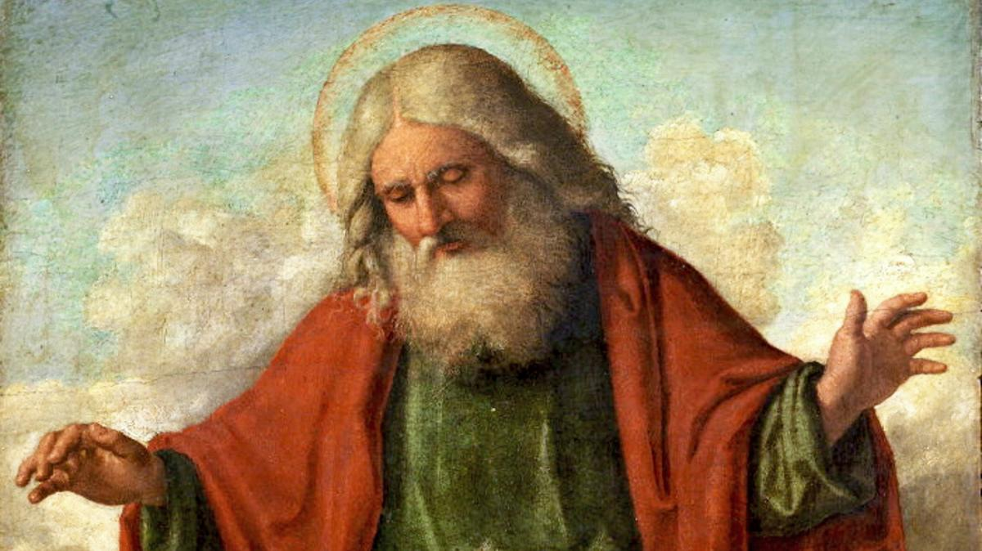
“Divine Command” Theory
(2.4)
Holy books contain God’s directions on how to act
Divine Command Theory:
Actions that align with the will of God = Morally good
Actions that go against will of God = Morally bad
Not a workable ethical theory according to the book (Not culture-neutral)

Slide 4
Cases FOR and AGAINST
Divine Command Theory
(2.4.1 + 2.4.2)
AGAINST
Different Holy books may contradict each other
Not realistic for multicultural society
Not all moral problems are addressed in scripture
Based on obedience, not reasoning
FOR
God is All-Good + All-Knowing
God = Ultimate Authority
If God created everything, we are obligated to follow God’s rules

Slide 5
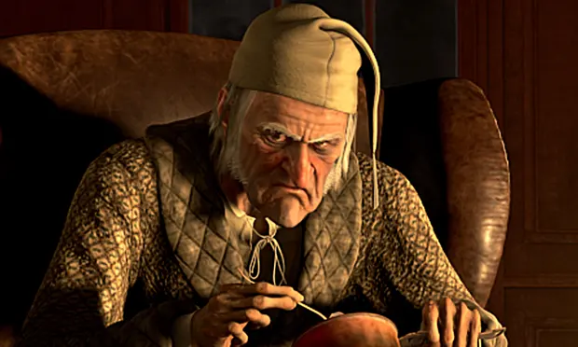
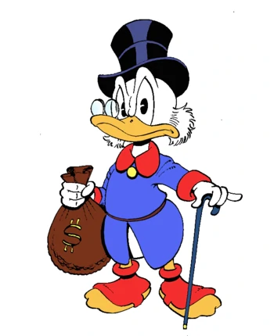
Ethical Egoism
(2.5)
Each person should focus on acting in their own self-interest
Action that provides the maximum benefit to you = Morally Correct
Doesn’t prevent helping others, but only when it is in your best interest
NOT a workable ethical theory (ignores ethical point of view)

Slide 6
Cases FOR and AGAINST
Ethical Egoism
(2.5.1 + 2.5.2)
FOR
Practical
Individuals putting their well-being first can benefit the community
Self-Centered, but can still be rational
AGAINST
Easiest Philosophy =/= Best
Not realistic for multicultural society
A self-interested focus can lead to blatantly immoral behavior
People who take the good of others into account live happier lives

Slide 7
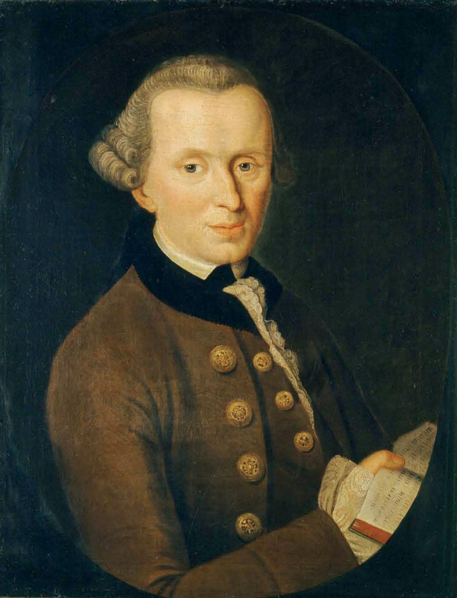
Kantianism
(2.6)
Ethical theory of German philosopher Immanuel Kant
Lived from (1724 - 1804)
Believed that people’s actions should be guided by universal moral laws
Believed those laws should be based on reason
Meets the criteria for a workable ethical theory by the book
Immanuel Kant

Slide 8
Good Will / Categorical Imperative
(2.6.1)
Kant believed the only thing in the world that is truly good without qualification: a good will
To Kant, what you WANT to do doesn’t matter, only what you SHOULD do
Dutifulness: The feeling of obligation to do what you should
Categorical Imperative: An unconditional rule
Two of Kant’s categorical imperatives:
1. Act only from moral rules that you can at the same time will to be universal moral laws.
2. Act so that you always treat both yourself and other people as ends in themselves, and never only as a means to an end.

Slide 9
Example of Kantianism in Practice
(2.6.2)
Scenario - Carla is a single mother who:
Takes care of her daughter, who she wants to spend more time with.
Has a full-time job
Taking two evening courses per semester
Will graduate if she passes both classes this semester
One of her required classes is Modern European History:
The professor assigns four lengthy reports
Students must submit all four reports in order to pass the class.
Carla earns an A on each of her first three reports. She does not have time to research and write the final report. Carla uses the Web to identify a company that sells term papers. She purchases a report from the company and submits it as her own work.
Was Carla’s action morally justifiable?

Slide 10
Example of Kantianism in Practice
(2.6.2)
Analysis
First Categorical Imperative
Proposed moral rule: “I may claim academic credit for a report written by someone else.”
If everyone followed this rule:
Reports would cease to be credible indicators of the students’ knowledge, and
Professors would not give out grades for reports.
The proposed moral rule is self-defeating and wouldn’t work, so it is WRONG for Carla to purchase a report and turn it in as her own work.
Second Categorical Imperative
Carla treated her professor as a means to an end by deceiving her professor with the goal of getting credit for someone else’s work.
It was wrong for Carla to treat the professor as a grade-generating machine rather than a rational agent with whom she could have communicated her unusual circumstances.

Slide 11
Cases FOR and AGAINST
Kantianism
(2.6.3 + 2.6.4)
FOR
Treats all people as moral equals
Treats people with an inherent dignity and respect
Everyone gets held to same standard
Produces universal moral guidelines
AGAINST
Not every action can be characterized by a rule
When rules conflict, no way of choosing which rule to follow
Allows no exceptions to “perfect duties”

Slide 12
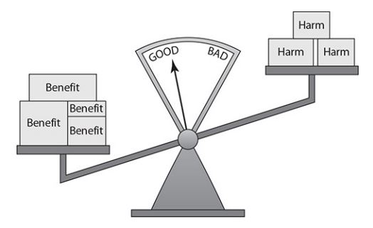
Act Utilitarianism
(2.7)
Ethical Theory proposed by Jeremy Bentham and John Stuart Mill
Theory (named Utilitarianism) :
Action’s benefits exceed its harms = Good action
Action’s harms exceed its benefits = Bad action

Slide 13
Principle of Utility
(2.7.1)
Utility - Tendency of an object to produce happiness or prevent unhappiness for an individual / community
Principle of Utility (Greatest Happiness Principle)
An action is right (or wrong) to the extent that it increases (or decreases) the total happiness of the affected parties.
Act utilitarianism: An action is good if its net effect (over all affected beings) is to produce more happiness than unhappiness.
Suppose we measure pleasure as a positive number and pain as a negative number.
Moral evaluation of an action:
Add up, over all affected beings, the change in their happiness.
If the sum is positive, the action is good. If the sum is negative, the action is bad.

Slide 14
Evaluating a Scenario Using
Act Utilitarianism
(2.7.2)
Scenario: A state is considering replacing a curvy stretch of highway that passes along the outskirts of a large city. Would building the highway be a good action?
150 Houses are in the path of the new highway
Paying homeowners: $20 Million
Construction : $10 Millon
Environmental Impact: $1 Million
Overall cost of Highway: $31 Million
Over 25 Years, drivers are expected to save $39 million due to new, shorter highway
Result:
The overall cost is lower than the potential benefit, so building the highway is a GOOD action.

Slide 15
Cases FOR and AGAINST
Act Utilitarianism
(2.7.3 + 2.7.4)
FOR
Focuses on Happiness
Practical
Comprehensive
AGAINST
Can be unclear when deciding what is/isn’t important
Calculating every moral decision one can make is unrealistic
Ignores how normal people make moral decisions
Hard to predict consequences of an action

Slide 16
Any Questions?
Topics Covered:
Divine Command Theory
Ethical Egoism
Kantianism
Act Utilitarianism

